Slide 1
MNML
MNML

Slide 2

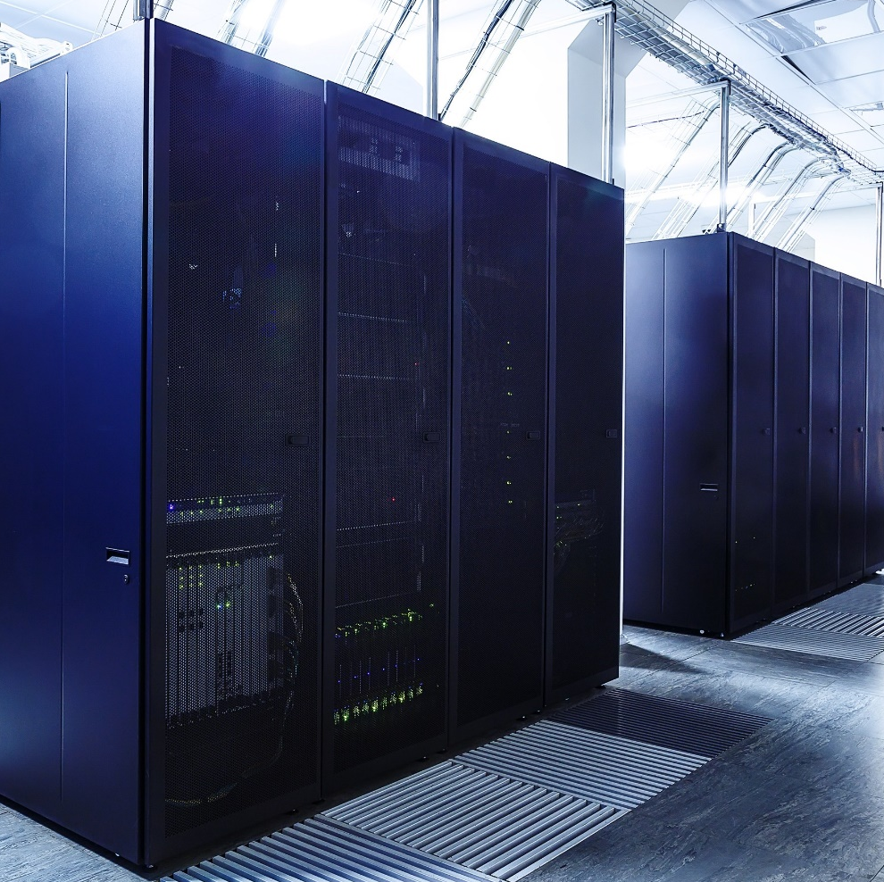
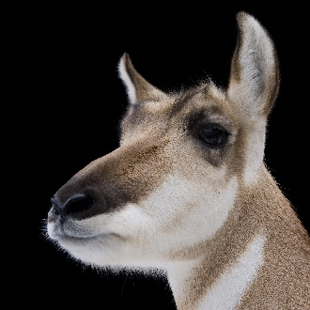
University of Nevada, Reno

